Slide 1
Welcome!
Sunday
Bible Study 9:30 AM
Worship 10:30 AM
Wednesday
Bible Class 7:00 PM
www.SunsetchurchofChrist.net

Slide 2
John 8:21-30
Jesus reveals His goal
Belief in Jesus
Speaking from the Father

Slide 3
Welcome!
Sunday
Bible Study 9:30 AM
Worship 10:30 AM
Wednesday
Bible Class 7:00 PM
www.SunsetchurchofChrist.net

Slide 4
Opening Prayer | Stan Mellor
Song – 1 | George Watkins
Scripture Reading | Ryan Sollars
Song – 110 | George Watkins
Song – 166 | George Watkins
Lord’s Supper | Ryan Sollars / Luis Gonzalez
Song – 556 | George Watkins
Collection | Ryan Sollars / Luis Gonzalez
Song – 172 | George Watkins
Lesson | Brian Haines
Song – 329 | George Watkins
Closing | Grant Haines

Slide 5
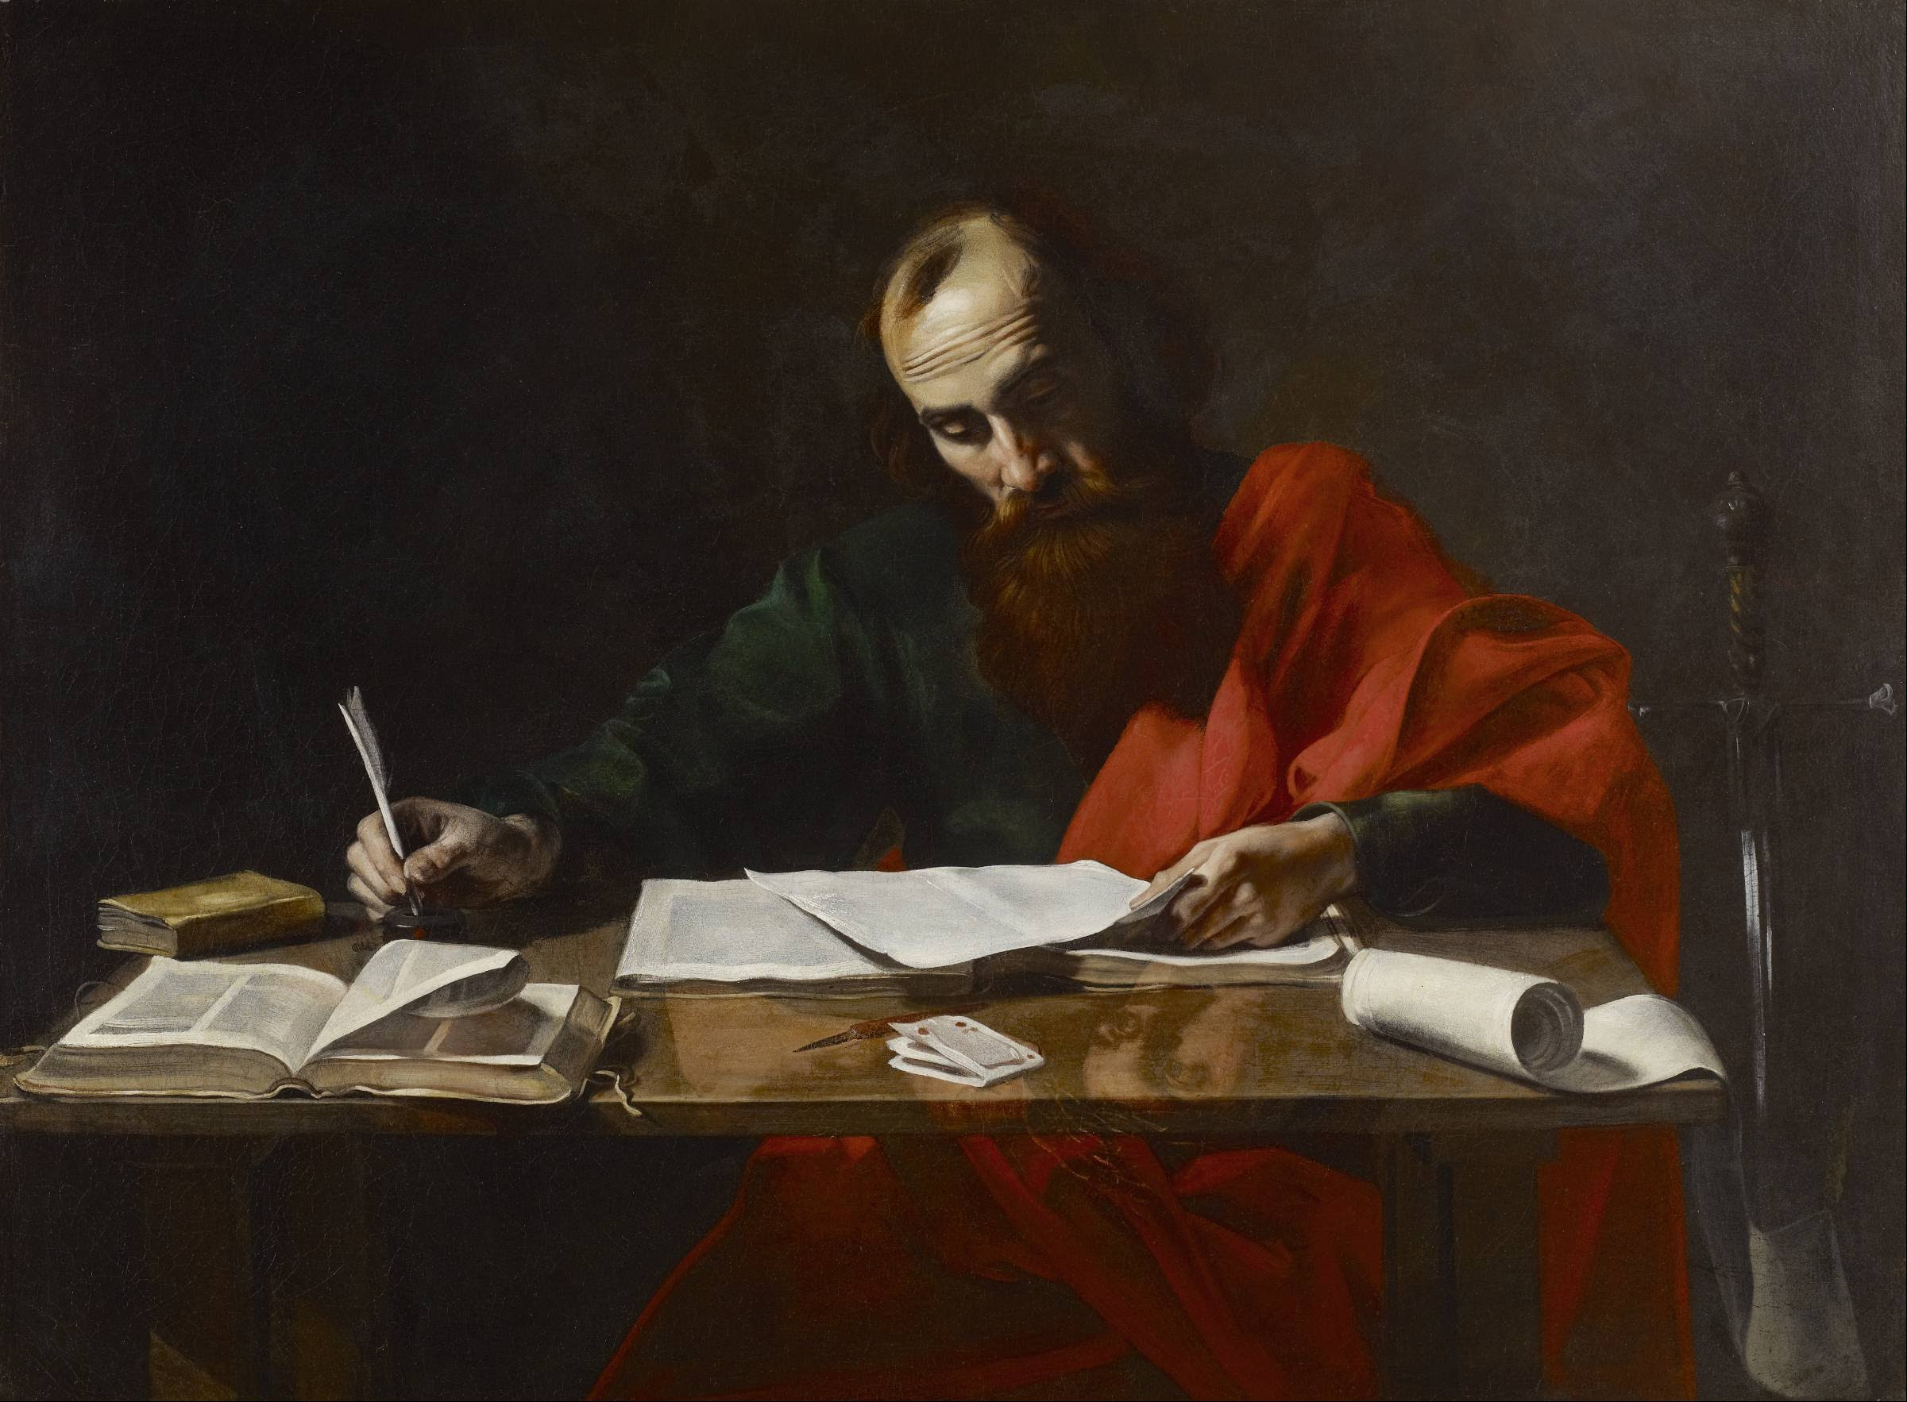
Paul’s Corinthian Advice
1 Corinthians 11
The Lord’s Supper
Notes:
Begin reading at vs. 15

Slide 6
Feast Days of Moses
Passover
Unleavened Bread
First-Fruits
Pentecost
Trumpets
Tabernacles
Atonement ……………….Use of the Fruit of the Vine

Slide 7
Feast Days of Moses
Passover – 1 Corinthians 5:7
Unleavened Bread – 1 Corinthians 5:8
First-Fruits – 1 Corinthians 15:20
Pentecost – (1 Corinthians 15:23)
Trumpets – 1 Corinthians 15:52
Tabernacles – 2 Corinthians 5:1-4
Atonement – (1 Corinthians 6:11)it of the Vine

Slide 8
The Lord’s Supper
A memorial - “In remembrance of me”
A proclamation of the Lord’s death
By the emblems
Flesh and Blood
Death and Life

Slide 9
The Lord’s Supper
A memorial - “In remembrance of me”
A proclamation of the Lord’s death
A proclamation of the Lord’s resurrection
By the day of observance
Acts 20:7

Slide 10
The Lord’s Supper
A memorial - “In remembrance of me”
A proclamation of the Lord’s death
A proclamation of the Lord’s resurrection
A proclamation of the Lord’s return
By those with whom we partake
Those who eagerly await His return

Slide 11
Feast Days of Moses
Passover
Unleavened Bread
First-Fruits
Pentecost
Trumpets
Tabernacles
Atonement ……………….Use of the Fruit of the Vine

Slide 12
Feast Days and Worship Today
Passover …………………Looking back to His Sacrifice
Unleavened Bread ………Use of Unleavened Bread
First-Fruits ………………………..First Day of the Week
Pentecost …………………………..Partaking with Saints
Trumpets ………………………………….Self Examination
Tabernacles ………………………..Looking to His return
Atonement ……………….Use of the Fruit of the Vine

Slide 13
Paul’s Admonition
The Corinthians were partaking unworthily
By not discerning the body of Christ

Slide 14
Paul’s Admonition
The Corinthians were partaking unworthily
By not discerning the church
Not waiting for each other
Partaking for themselves

Slide 15
Paul’s Admonition
The Corinthians were partaking unworthily
By not discerning the church
Communion is an act of Love
For Christ
For one another

